Slide 1

A SAT Solver + Computer Algebra Attack on
the Minimum Kochen–Specker Problem
Brian Li¹, Curtis Bright², Vijay Ganesh¹
¹ Georgia Institute of Technology and University of Waterloo
² University of Windsor

Slide 2
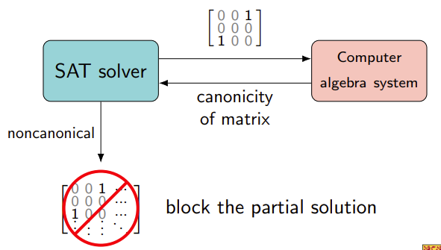
CDCL(CAS) paradigm
SAT solvers:
Strength: excellent search capabilities
Weakness: lack mathematical knowledge
CAS systems:
Strength: Storehouse of mathematical knowledge
Weakness: lack search capabilities
SAT+CAS = excellent search + mathematical knowledge

Slide 3
Applications of the SAT + CAS Paradigm
Introduced by Zulkoski, Ganesh et al.[1], and independently by Erika Ábrahám [2], both in 2015, the SAT + CAS paradigm has made defining contributions in combinatorics and graph theory:
Verified Lam's problem and produced the first set of nonexistence certificates
Found the smallest counterexample of the Williamson conjecture for the first time
First independent verification of the Craigen–Holzmann–Kharaghani conjectures about complex Golay pairs up to length 28
Proved the best known result in the conjecture that every matching of a hypercube extends to a Hamiltonian cycle (Ruskey–Savage conjecture)

Slide 4
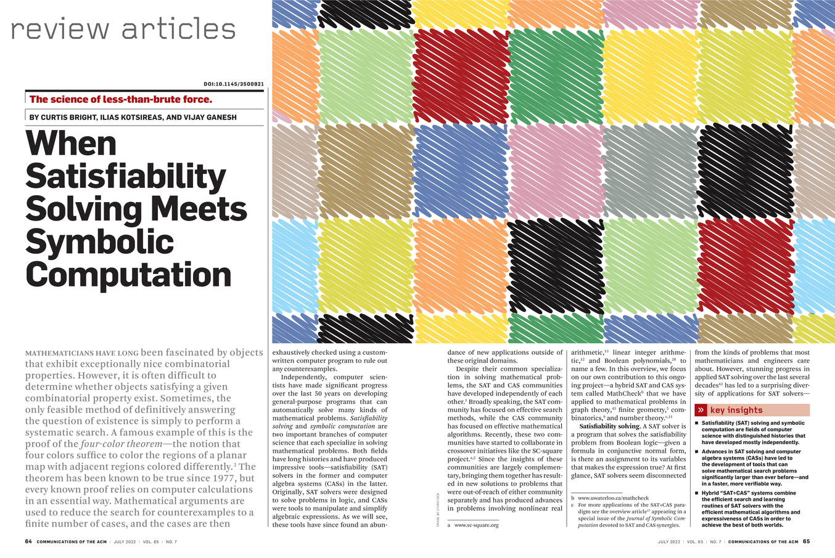
Satisfiability (SAT) + Computer Algebra Systems (CAS)
￼

Slide 5
Our Main Result: SAT+CAS for Minimal Kochen-Specker Problem
The first ever successful implementation of the satisfiability solver + computer algebra system approach (SAT + CAS) for problems in quantum foundations, namely, the minimal Kochen-Specker vector system problem.
We improved the lower bound on the size of the KS system from 22 to 23, with a significant speed-up (30,000x) over previous computational approaches.

Slide 6
Quantum Foundations: Goals and Problems
“Explain” counter-intuitive aspects of Quantum Mechanics (QM) such as non-locality, contextuality, complementarity, entanglement,...
Answer questions such as the measurement problem
Attempts include Copenhagen Interpretation, Hidden Variable theories
Axiomatize QM in logic and study its meta properties, e.g., soundness, relationship to classical logic, proof systems etc.

Slide 7
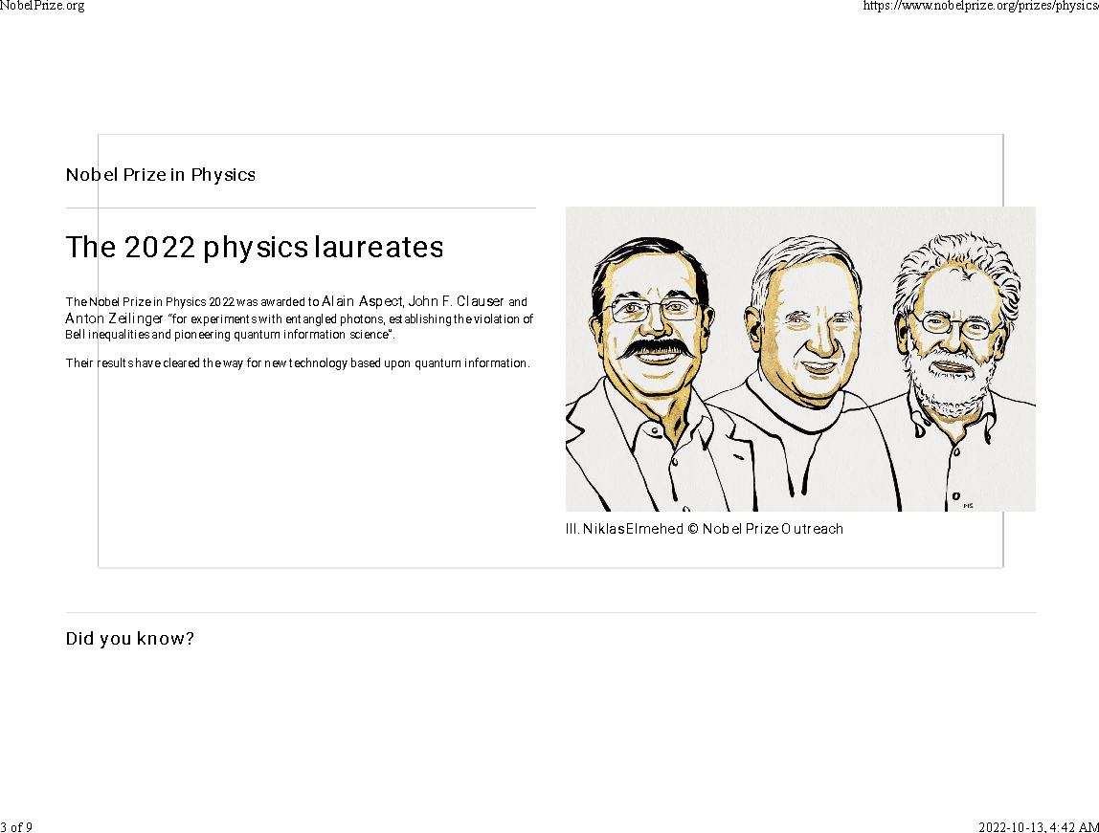

Slide 8
The Kochen-Specker and Free-Will Theorems
The Kochen-Specker (KS) Theorem states that there is a contradiction between the SPIN axiom of standard quantum mechanics and the assumption of non-contextuality [3]. (More precisely, there is a contradiction between empirical predictions of QM and the following three properties one assumes all systems must possess: value-definiteness + non-contextuality + one-one Hilbert correspondence.)
The Free Will theorem, proposed by John Conway and Simon Kochen, is a result in quantum mechanics that challenges determinism. The theorem is based on and extends the Kochen-Specker theorem, which shows the limits of our ability to know the properties of a quantum system.

Slide 9
Spin of a Particle
One of the central ideas of quantum mechanics is the notion of spin. Certain subatomic particles have spin. Given a direction, a particle can spin up (positive), down (negative), or not at all.

Slide 10
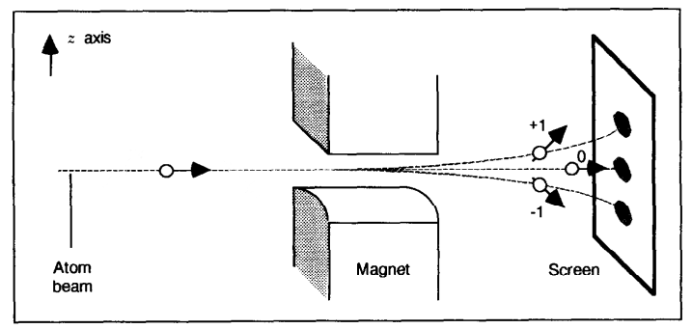
Observing SPIN - The Stern–Gerlach Experiment (1922)
We can observe the particle spinning by performing such experiment.
The spin of the atom (in the direction of the field) is +1, −1, or 0.

Slide 11
The Kochen–Specker Experiment
Measure the squared spin of a SPIN-1 particle in three mutually orthogonal directions.

Slide 12
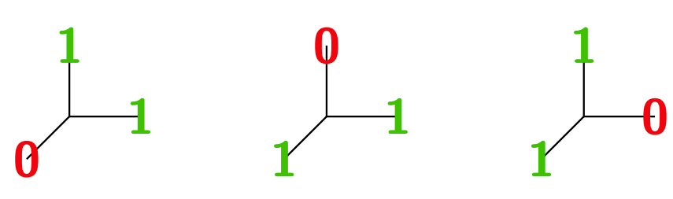
The SPIN Axiom
The squared spin of spin-1 particles measured along three orthogonal directions is zero in exactly one of these directions.
Antipodal directions have the same squared spin.

Slide 13
What is Non-Contextuality?
Intuitively, non-contextuality asserts that if a QM system possesses a property (value of an observable), then it does so independently of any measurement context, i.e., independently of how that value is eventually measured.
The KS theorem asserts that any non-contextual hidden variable theory cannot reproduce the predictions of QM.
Put differently and informally, the act of measurement creates properties/reality as we understand it. Prior to measurement, QM system don’t have any fixed properties, i.e., they are in a superposition of all possible values of an observable.

Slide 14
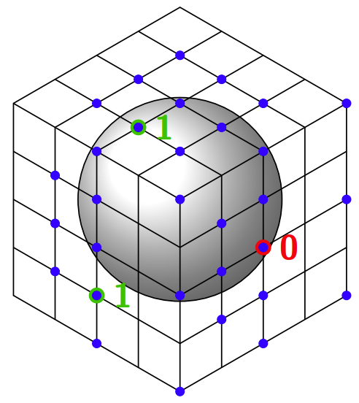
Recap: The Kochen–Specker Theorem
There is a contradiction between the SPIN axioms and non-contextuality. It is impossible to assign {0, 1} values to the following 31 vectors in a way that does not violate the SPIN axiom. The particle cannot have a predetermined spin in every direction. [Kochen & Specker 1967]
31 vector KS system of Conway and Kochen, 1990.

Slide 15
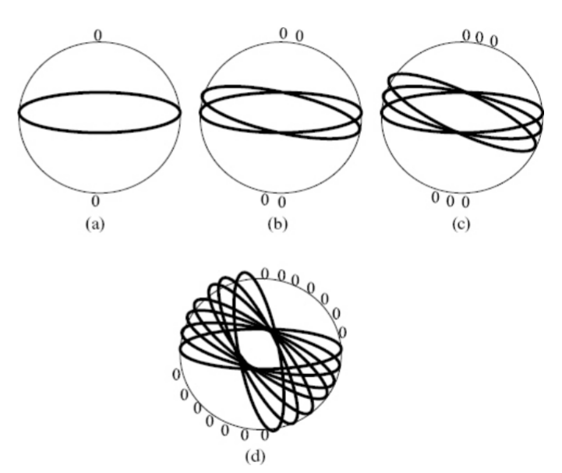
Intuition behind the KS Theorem
If the North pole direction does not have spin (0), then the South pole direction also lacks spin. Then all directions along the equator must have spin 1 (a).
Assign the direction slightly to the right of the North pole as 0 (b) and continue doing so until we reach (d).
It’s impossible to continue this process until every point on the sphere is assigned either 0 or 1.
FIgure 7.17 from The Outer Limits of Reason by Noson S. Yanofsky

Slide 16
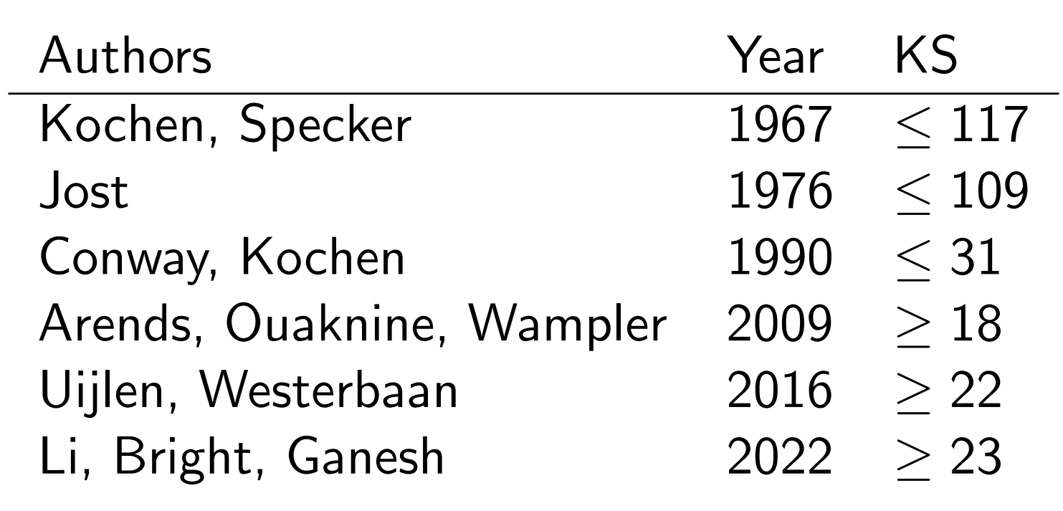
Related Work on the KS Problem
Table: A history of the bounds on the size of the minimum KS system.

Slide 17
Converting SPIN axiom to SAT via Graph Colorability
The squared spin components of a spin-1 particle are 1, 0, 1 in these three directions.
Thus, the observable corresponding to the question “is the squared spin 1?” measured in three mutually orthogonal directions will always produce no in exactly one direction and yes in the other two orthogonal directions in 3-dimensional Euclidean space.
Satisfying the SPIN axiom is equivalent to being 101-colorable (dually, 010-colourable):
Two adjacent vertices are not both assigned to 0 (dually, 1)
Three mutually adjacent vertices are not all assigned to 1 (dually, 0)

Slide 18
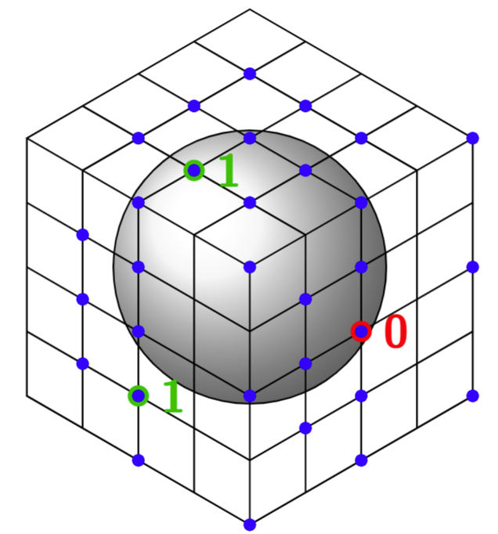
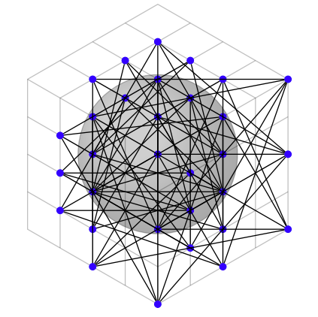
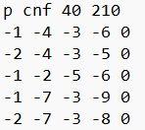
Encoding the KS Problem
To find a KS system, we want to find graphs G such that
G is non-101-colorable: G has no possible 101-coloring
G is embeddable: G is an orthogonality graph for a 3-d vector system
In addition, previous research has proven mathematically that G satisfies
Squarefree Constraint: G must not contain a square subgraph
Minimum Degree Constraint: every vertex of G must have minimum degree 3
Triangle Constraint: every vertex is part of at least one triangle subgraph

Slide 19
SAT+CAS Solver

Slide 20
SAT Symmetry Breaking
A SAT approach outperformed the previously used graph enumeration
approach. However, a SAT solver generates many isomorphic copies of the
same graph.
Thus, we combine SAT with isomorph-free exhaustive generation (also
previously used to solve Lam’s problem) [Bright, Cheung, Stevens, Kotsireas, and G. 2021].

Slide 21
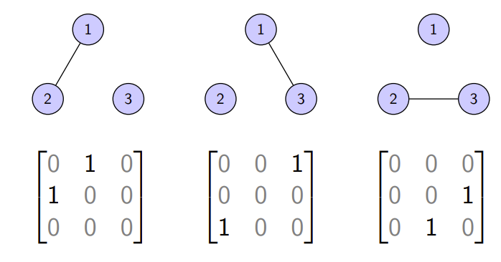
Key Insight: Symmetry Breaking in SAT+CAS
The SAT approach outperforms other graph enumeration approach—but the solver generates many isomorphic copies of the same graph.

Slide 22
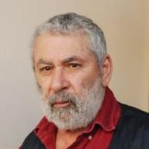
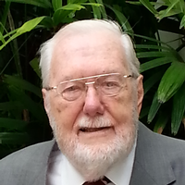
Isomorph-free Orderly Generation
When generating combinatorial objects we only care about generating them up to isomorphism.
The notion of canonicity is defined so that:
Every isomorphism class has exactly one canonical representative.
If an adjacency matrix is canonical then its upper-left submatrix of any size is also canonical.
Developed independently by Faradžev and Read in 1978.

Slide 23
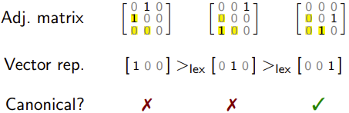
Canonicity Examples
An adjacency matrix is canonical if its “vector representation” is lex-minimal among all matrices in the same isomorphism class.
For example,
are isomorphic adjacency matrices but only the last is canonical.

Slide 24
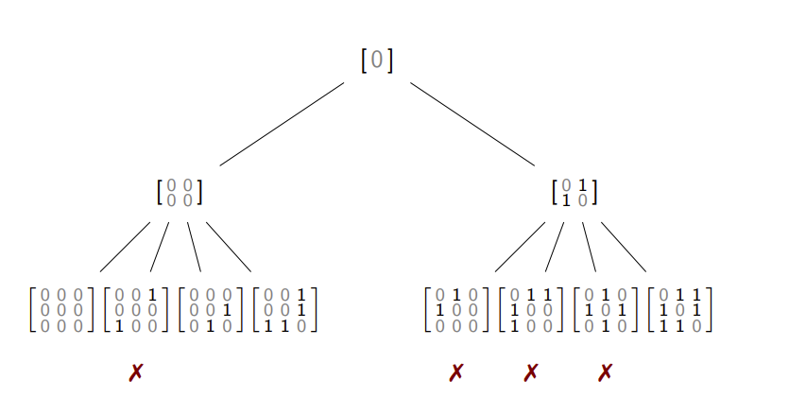
Orderly Generation of Graphs

Slide 25
Orderly Generation in Practice
Each canonical test is independent, making the method easy to parallelize.
Verifying a matrix is non-canonical is often fast - it requires finding a single
permutation of the vertices giving a lex-smaller matrix.

Slide 26
SAT and Isomorph-free Generation
Only recently have there been attempts at combining isomorph-free
generation and SAT solving. [Junttila, Karpa, Kaski, and Kohonen 2020. Savela, Oikarinen, and Jarvisalo 2020. Kirchweger and Szeider 2021]
This is perhaps a result of the historical separation between the SAT and
symbolic computation communities. We will now discuss applying orderly
generation and SAT to the minimum Kochen–Specker problem.

Slide 27
Orderly Generation with SAT Solver

Slide 28
Implementation – Cube-and-Conquer
The cube-and-conquer satisfiability solving paradigm was developed to
solve hard combinatorial problems.
A “cubing solver” splits a SAT instance into a large number of distinct sub-problems specified by cubes-formulas.
For each cube a “conquering solver” solves the original instance under the assumption that the cube is true.
For large orders, parallelization is applied by dividing the instance into
smaller subproblems using the cube-and-conquer approach. During the
splitting, cube-and-conquer finds the next variable that splits the search
space the most evenly.

Slide 29
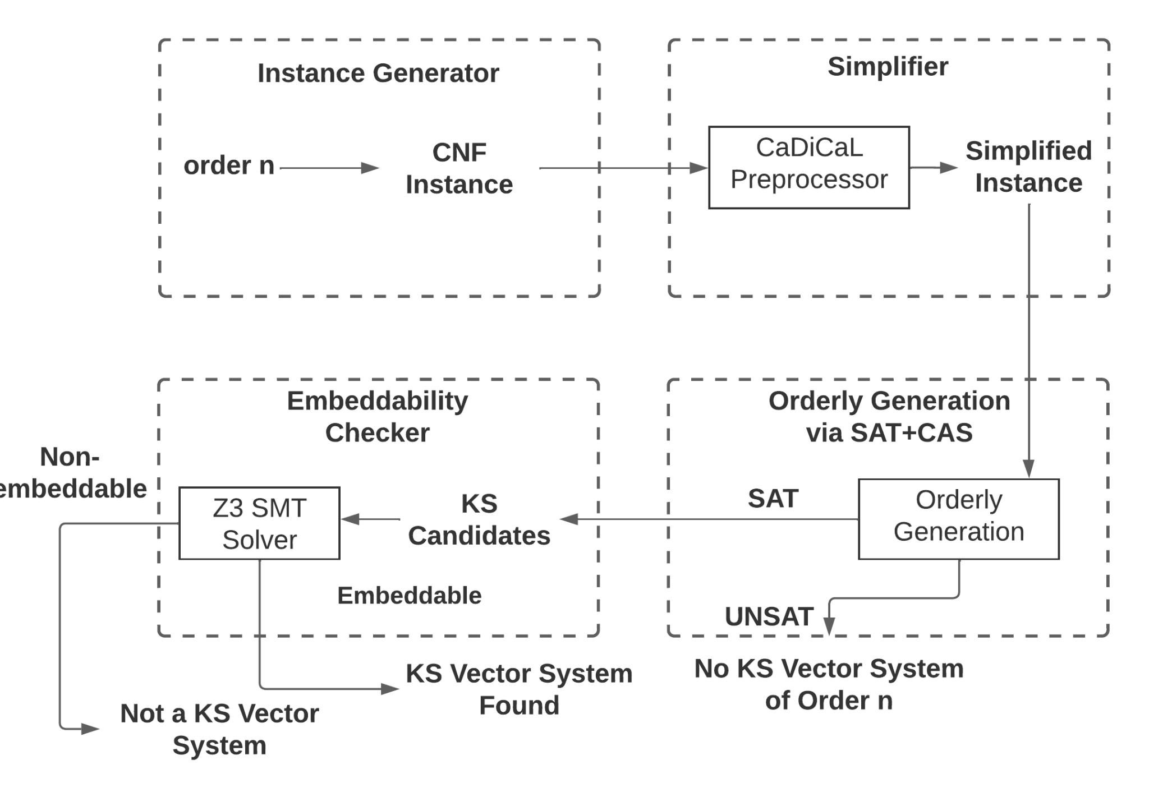
Pipeline Overview

Slide 30
Verification
SAT: We have enabled DRAT proof logging in the SAT solver so that certificates are generated.
CAS: a CAS-derived permutation provides a witness that the blocked matrix is non-canonical.
We used a slightly-modified DRAT-trim (to trust CAS derived clauses) to verify the correctness of the DRAT proof and a permutation-applying Python script to verify its CAS derived clauses.
We have certified the results up to order 21 so far and the original uncompressed proofs are about 200GB in total.

Slide 31
Results
Order | SAT only | CAS only (Nauty) | SAT + CAS | Speedup over SAT | Speedup over CAS
17 | 10.8 min | 25.0 min | 0.3 min | 36.1x | 83.2x
18 | 53.7 min | 395.6 min | 1.7 min | 31.6x | 232.7x
19 | 6.5 days | 6.2 days | 13.8 min | 675.9x | 639.7x
20 | N/A | N/A | 109.4 min | N/A | N/A
21 | N/A | N/A | 1383.6 min | N/A | N/A
22 | N/A | N/A | 19 days | N/A | N/A
The order 21 case was resolved in under a day on a single desktop, while the best previous approach used 300 desktops for three months. Our method is 30,000x more efficient on the same hardware than the previous best approach by Uijlen and Westerbaan 2016.

Slide 32
Conclusion: SAT+CAS for Problems in Quantum Foundations
We improve the lower bound over the minimum KS vector system problem and the search efficiency by 30,000x.
We provide a rigorous verification of our result via generation of DRAT proofs.
We demonstrate the benefits of the SAT + CAS paradigm for a problem in quantum foundations, showing that it is more effective and less error-prone as we uncover inconsistencies with previous result by Uijlen and Westrebaan 2016.
Future directions: heuristic search, programmatic encoding of non-colorability constraints

